Slide 1
Current Initiatives and COVID Report
Diane Tyler, PhD, RN, FNP, CAE
Director of Certification
American Academy of Nurse Practitioners Certification Board
National Credentialing Forum
February 4-5, 2021

Slide 2
Who is AANPCB
AANPCB – national NP certifying organization
  Recognized in all U.S. states and Canada for licensure
  Currently > 160,000 certified NPs
  Offer certification by examination for FNP, A-GNP, ENP
  # new certificants annually 15,000 – 20,000
  # renewals processed in 2020 = 20,000
  Renewal required every 5 years for all certificants
  Current recertification rate = 95%

Slide 3
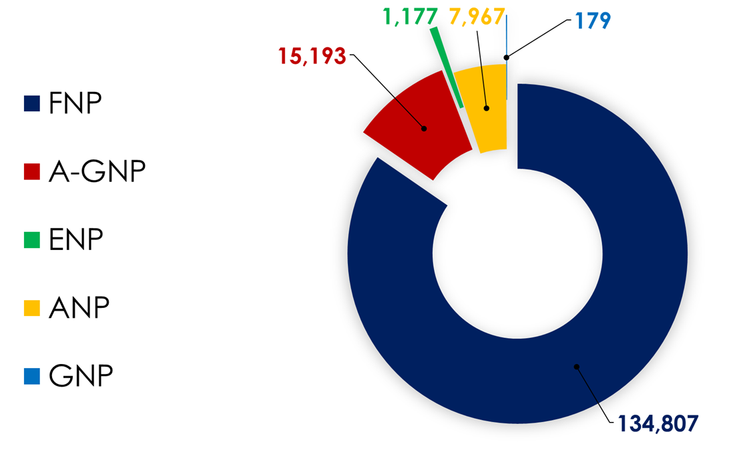
2020 At a Glance
Total number of active certifications = 159,323

Slide 4
Number of Certifications

Slide 5
Maintenance of Certification
Renewal requirements to demonstrate continued competence
  Recertify by examination (new exams developed annually)
  Completing Clinical Practice + CE
  Clinical Practice + CE is only option for ANPs & GNPs since these certification programs no longer have examinations available
  Requirements must be met during certification period, prior to expiration
Task Force established to review currency of MOC requirements

Slide 6
COVID Impact
Certification renewal requirements
  Closure of testing centers, CE conferences canceled, practices closed/downsized
AANPCB approved exception policy
  Temporary Certification Extension of 120 days to complete requirements
  # requests for TCE; # approved
Students
  Incomplete clinical hours due to clinical agency restrictions. Graduations delayed.
Licensing boards had varied adjustments in policies
  Temporary license granted to those eligible to test, some temporarily waived license renewals
Certifiers
  Eligibility to test notification provided to state boards
  Dates of the temporary certification extensions

Slide 7

Current Initiatives and Networking
Live remote proctoring for high stakes certification exams
AANPCB Recertification Task Force
NCSBN initiated email communication with APRN certifiers
ABNS held monthly web-based meetings for members and non-member organizations
NONPF – position statement on acceptable minimum NP program requirements for students

Slide 8
Q & A
The American Academy of Nurse Practitioners National Certification Board, Inc.
PO Box 12926
Austin, TX 78711
Main (512) 637-0500
Toll-free (855) 822-6727
Fax (512) 637-0540
Certification@aanpcert.org
www.aanpcert.org

